Slide 1
2024
Robo Advice & Wealthfront Review
If you decide to sign up with Wealthfront based on this review, please use this link as we each get an extra $5,000 managed free.
My review based on seven years of use.
Cave Arnold – CFP, RICP
Cavearnold@gmail.com

Slide 2
What is a Robo Advisor?
10
Use software algorithms to automate complex financial transactions. (i.e., ATMs instead of Bank Tellers)
Have human investment officers that decide which investment offerings for a given risk and reevaluate periodically.
Generally, use broad market low-cost index funds in an exchange traded fund (ETF) wrapper for tax efficiency.
May offer goal oriented financial planning projections.
Allow a one stop shop for retirement accounts. (Brokerage, Cash, IRA, Roth IRA, 529, etc.)

Slide 3
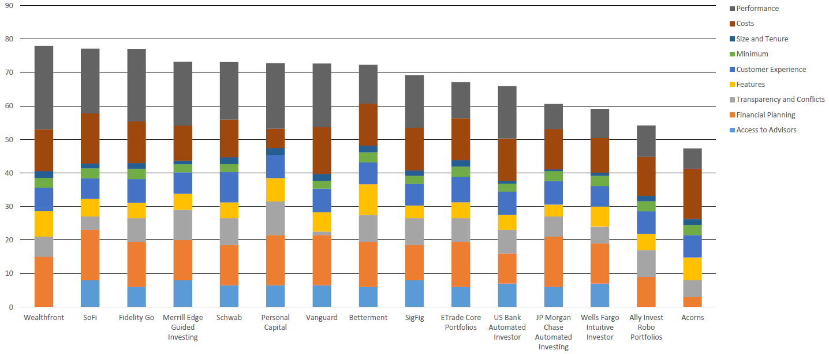
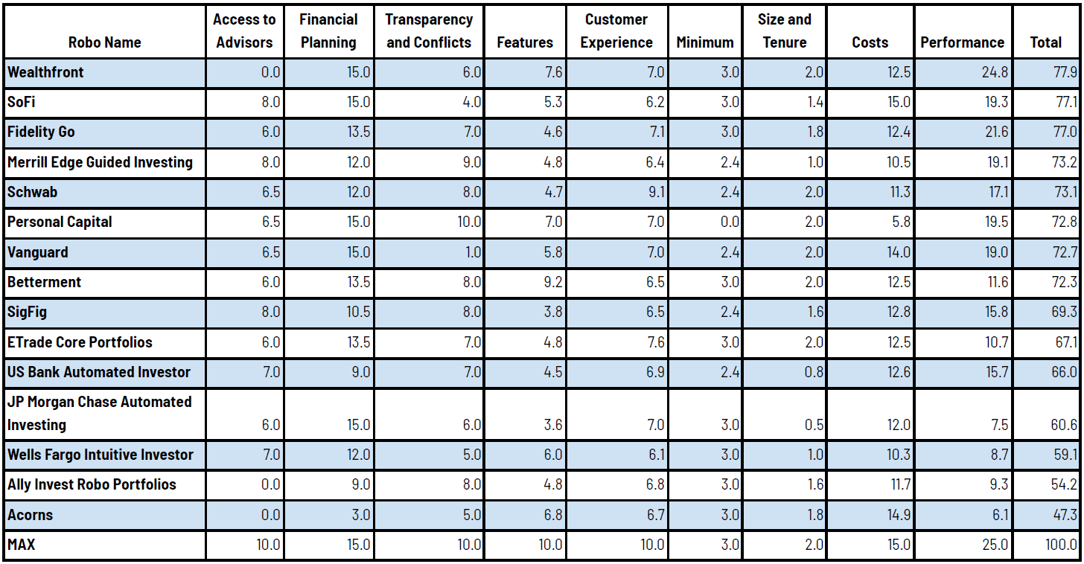
The Robo Landscape
9
The Robo Report
  In 2017 I did my own evaluations. Now there is a group that is focused on providing independent guidance on performance.

Slide 4
Risk Profiling
8
Wealthfront has a risk questionnaire that is used to assign a risk score.
  Risk scores define which of the base allocations to start with.
    The risk analysis questionnaire was not sufficient to capture all risk mitigating factors.
    I increased to match an 80/20 split at 50 and a 90/10 split at 55.
    This aligned with my taking most of my pension as an annuity and not a lump as I had initially planned.

Slide 5
Parametric Rebalancing
7
Wealthfront maintains the original assigned allocation.
  Parameters are used as percentages off before a rebalance occurs.
  If regular deposits are being made or dividends are re-invested, then those are invested to maintain asset allocation first.
  If a change in asset class price occurs that exceeds the set parameter limit.
    Sell higher valued assets and buy lower valued assets to realign.
      This automatically maintains a sell high - buy low methodology.
      The parameter makes the sales as soon as a percentage of drift has occurred rather than on fixed dates like end of year or middle of year or quarterly which are arbitrary.

Slide 6
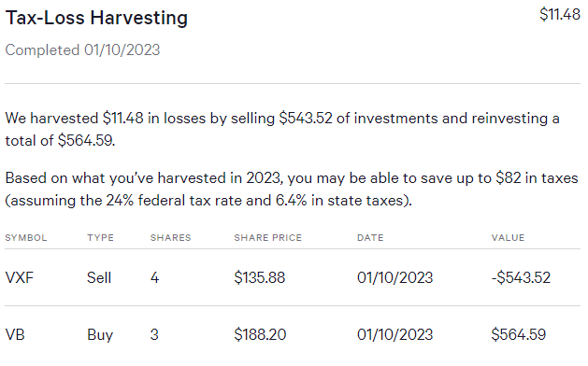
Tax Loss Harvesting
6
Wealthfront will automatically perform tax loss harvesting based on a parametrized decrease in price.
  These harvested losses can
  then be used to offset gains.
  $3000 may also be used to lower
  tax liability.
  Any remaining losses may be
  carried forward to the next tax year.
  Wealthfront understands limitations
  such as the wash sale rule.
  Wealthfront also understands how to
  apply short term versus long term losses.

Slide 7
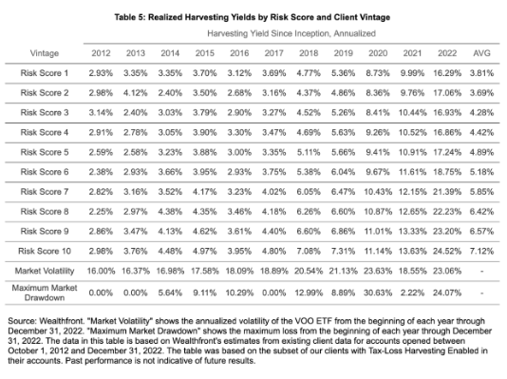
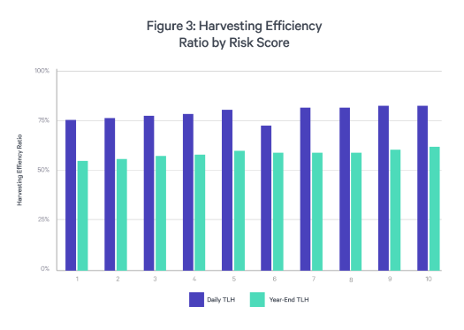
Tax Loss Harvesting
5
Wealthfront publishes actual TLH metrics for all risk scores historically.
Daily TLH versus annual TLH compared.

Slide 8
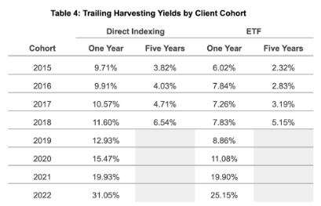
Direct Indexing
4
Wealthfront also performs direct indexing using 100 individual stocks from the S&P 500.
  This allows more tax loss harvesting as the individual stocks making up the index are more volatile than the index proper.
    This is only available at $100,000 level on taxable accounts.
    The table shown compares the TLH adjusted yields of
    Direct indexing versus the VTI ETF.
    This demonstrates the tax advantages of direct indexing
    over normal ETFs with TLH.

Slide 9
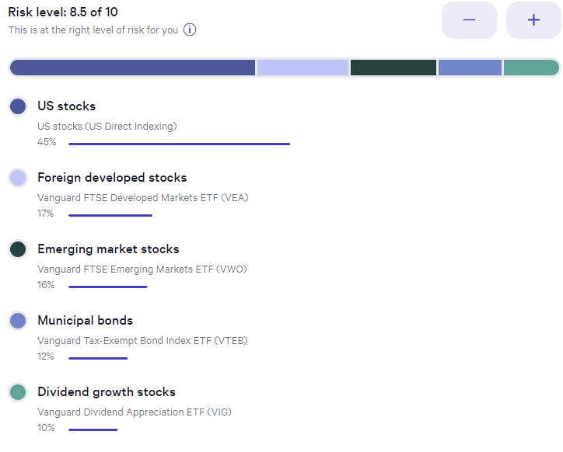
My annualized returns
3
Taxable Account
Shown are my current allocations
and annual returns.
2017 was partial from April and
2024 is year to date April.
2017 14.45%
2018 -8.85%
2019 25.48%
2020 12.28%
2021 12.55%
2022 -17.83%
2023 20.97%
2024 7.53%

Slide 10
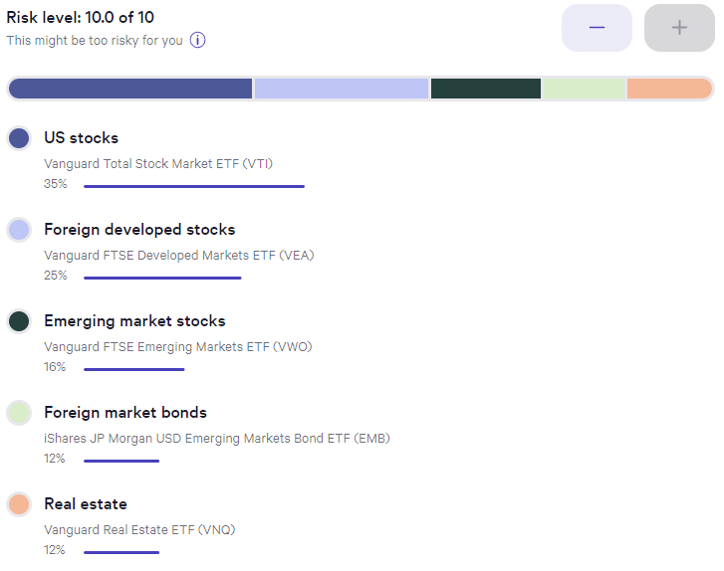
My annualized returns
2
Roth IRA Account
Shown are my current allocations
and annual returns.
2018 through 2023 max
IRA contributions made.
2018 -1.97%
2019 23.74%
2020 11.66%
2021 14,08%
2022 -18.86%
2023 16.82%
2024 2.23%

Slide 11
More Details
1
Wealthfront's Investment Methodology
Wealthfront's Tax Loss Harvesting Approach
Wealthfront's Direct Indexing Approach
Wealthfront's Management of Taxes and Fees

Slide 12
Needs Improvement
0
Risk Parity did not work better than bonds and had higher volatility. I sold out after 3 years.
Banking features are not complete.
No longer offer partial Roth conversions internally.
No automated investment withdrawals, even to their own cash accounts. (Using Sequence to eliminate this shortfall.)
Banking rates not competitive when interest rates are < 0.5%.
Quiz to determine risk score is inadequate.

